Slide 1
Keyloggers and security
CAPSTONE PROJECT
Presented By:
1. D.Karthika- Madha Engineering College-BE-CSE

Slide 2
OUTLINE
Problem Statement
Proposed System/Solution
System Development Approach
Algorithm & Deployment
Result
Conclusion
Future Scope
References

Slide 3
Problem Statement
In today's digital landscape, ensuring security measures to protect sensitive information is paramount. However, there exists a necessity to understand and mitigate potential threats, such as keylogging, which can compromise data integrity and confidentiality. Thus, it's imperative to explore keylogger implementation and associated security concerns.

Slide 4
Proposed Solution
Construction of our suggested system comprises the use of Python's Tkinter library for the GUI and the pynput package for keyboard input recording, to create a keylogger. Keystrokes are recorded by the keylogger and saved in text and JSON forms for further examination.

Slide 5
System Approach
Technology Employed:
Python: To program the features of the keylogger.
Tkinter: For constructing the GUI, or graphical user interface.
Python input: For recording keystrokes.
JSON: A structured format for recording keystroke data

Slide 6
Algorithm & Deployment
Initialization: Set up the flags and variables that are required.
Event Handling:
On_press(key): Documents pressed and held keys in the event handling system.
On_release(key): Maintains flag state and logs released keys.
Recording:
Save_text_log(key): Stores keyboard events in a text document.
Keystrokes are saved in a JSON file using the generate_json_file(keys_used) function.
Keylogger Management:
Start_keylogger(): Started the process of keylogging.
Stop keylogging with stop_keylogger().

Slide 7
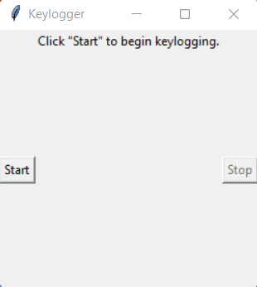
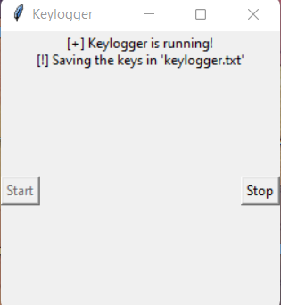
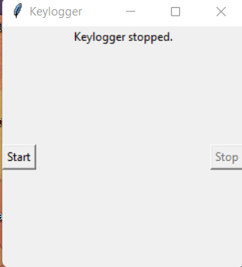
Result
The GUI presents "Start" and "Stop" buttons to control the keylogging process. Upon starting, the keylogger captures keystrokes and saves them in designated files. Stopping the keylogger halts the logging process.

Slide 8
Conclusion
Using a keylogger demonstrates how simple it is to record keyboard inputs and emphasizes how crucial strong security measures are to preventing unwanted access to private data. Gaining knowledge about keylogging techniques helps protect systems from possible attacks.

Slide 9
Future scope
Improving Security Measures: To secure logged data use encryption techniques.
User Authentication: To avoid unwanted access, incorporate user authentication measures.
Sophisticated Logging: Use feature like windows tracking and timestamping for sophisticated logging.

Slide 10
References
A Survey on Keylogger and its Detection Techniques by Vishal Bharti, Aditya Kumar Gupta, and Shailendra Mishra https://www.ijcaonline.org/archives/volume75/number5/12835-1514
Analysis of Keylogger Attacks and Countermeasures by Hongliang Liu, Ruiying Du, and Quansheng Zhuang https://www.semanticscholar.org/paper/Analysis-of-Keylogger-Attacks-and-Countermeasures-Liu-Du/54c7255bace229c82e4a5fd812ba8dd8829180c1
Detection of Keyloggers: A Review by Shukor Abd Razak, Ku Ruhana Ku-Mahamud, and Ramlan Mahmod https://www.researchgate.net/publication/220955239_Detection_of_Keyloggers_A_Review
A Comprehensive Study on Keylogger Attack and Defense by Shuo Chen, Rui Wang, XiaoFeng Wang, and Kehuan Zhang https://www.usenix.org/legacy/events/sec11/tech/full_papers/Chen.pdf

Slide 11
THANK YOU

